Slide 1
What to Wear to the 8th Grade Formal!
A NIGHT ON THE TOWN
These are some ideas on what to wear and what not to wear! Make the appropriate choice so you do not miss out on the fun!
Remember there are other dances in your future if your dream outfit is not appropriate for our 8th grade semi-formal!

Slide 2
The
TUCKER MIDDLE
SCHOOL
DRESS CODE MUST
BE
FOLLOWED
The choices in this presentation were chosen to fit all body types.
Thanks for your support

Slide 3
Long Dress
Remember, this is a semi-formal!
No long dresses!

Slide 4
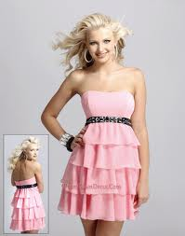
Strapless Dress
No Strapless Dresses

Slide 5
Spaghetti straps or sleeveless
Dress must have sleeves
No spaghetti straps or thin straps that provide little coverage

Slide 6
Spaghetti straps or strapless
All of these choices would not be appropriate!

Slide 7
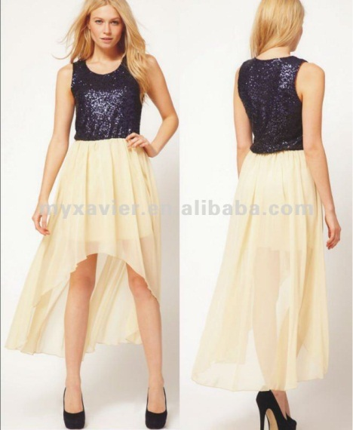
Thigh high splits or high low dresses that are too short in front
No thigh high splits
No high/low dresses -short front and long back (unless the front section is an appropriate length)

Slide 8
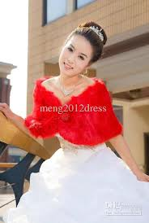
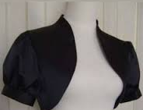
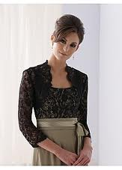
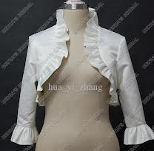
Strapless dresses are okay with a jacket
However....

Slide 9
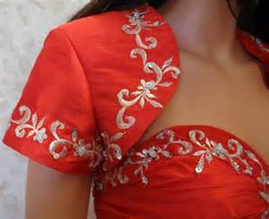
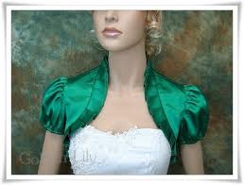
Strapless dresses are okay with a jacket

Slide 10
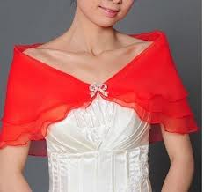
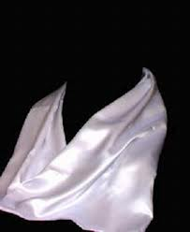
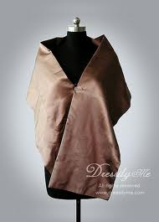
Wraps or shawls or scarves work well with strapless dresses too!
Girls have to wear it for the entire dance!!

Slide 11
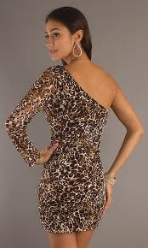
Too Short
One Sleeve
Off the Shoulder
Dresses must follow finger tip rule
Dresses must have 2 sleeves

Slide 12
No sleeves
Shows cleavage
Dresses have to follow dress code and be appropriate

Slide 13
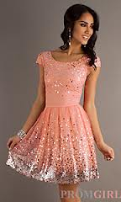
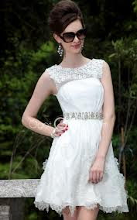
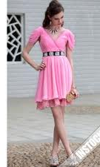
These are all good choices!!!
Length is appropriate
Each dress has sleeves or provides good coverage

Slide 14
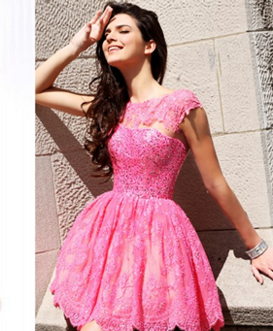
Additional dresses with appropriate styles to give you some ideas!

Slide 15
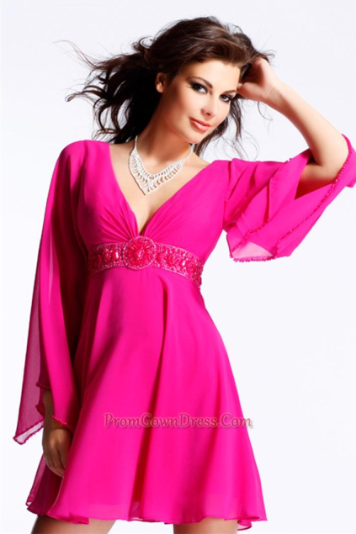
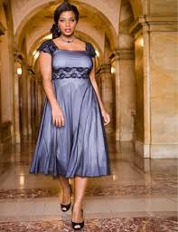
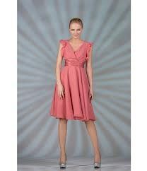
Length is appropriate
Has sleeves

Slide 16
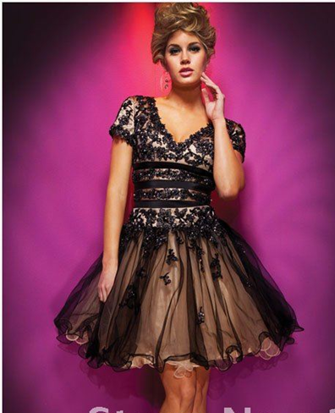
Appropriate length Has sleeves Back is covered

Slide 17
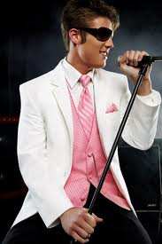
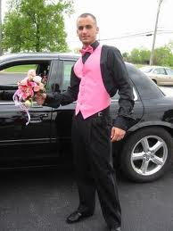
Boys can wear a tuxedo or a nice suit!

Slide 18
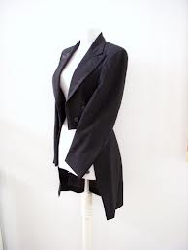
No tuxedos with tails

Slide 19
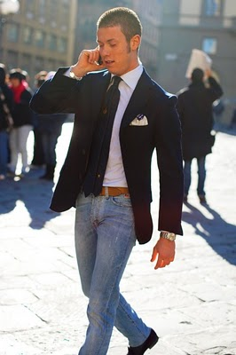
No Jeans or tennis shoes for anyone! No joggers

Slide 20
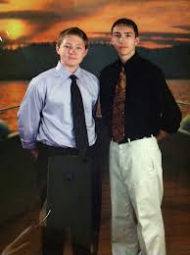
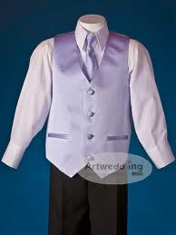
A nice shirt and tie is okay. Also a vest and tie is appropriate!

Slide 21
Thank you for adhering to
the dress code for the dance.
If you have any questions,
please ask in advance.
You can bring in a
picture of your outfit if you like
in advance and
show it to your administrator.

